Slide 1
AD9910
test & Verilog code

Slide 2
Contents
Evaluation Board Test
Verilog code & python code update for AD9910

Slide 3
DDS Chip | AD9914 | AD9912 | AD9910
Frequency(bit) | 32 – 64 | 48 | 32
Phase(bit) | 16 | 14 | 16
Amplitude(bit) | 12 | X | 14
DAC(bit) | 12 | 14 | 14
Max Out Freq | 1.2 GHz (1.75 GHz) | 400 MHz | 400 MHz
Max Sys Freq | 3.0 GHz (3.5 GHz) | 1 GHz | 1 GHz
SYNC_IN | O | X | O
 | Parallel & Serial(SPI) | Serial(SPI) | Serial(SPI)

Slide 4
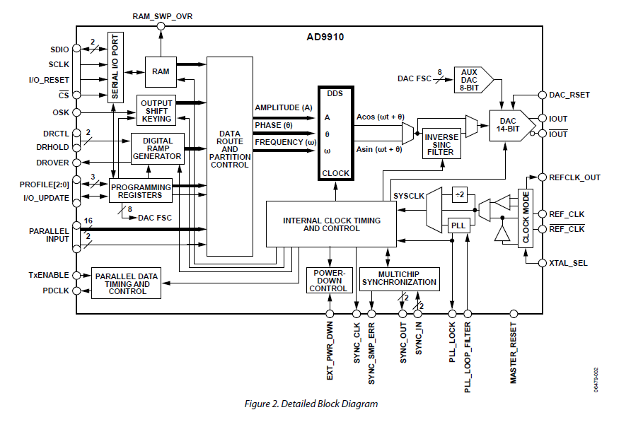
AD9910
4 mode available
Single ton mode (8 profile)
Ram mode (32 * 1024 RAM)
Parallel mode (real time parameter supply)
DRG mode

Slide 5
AD9910
4 mode available
Single ton mode (8 profile)
Ram mode (32 * 1024 RAM)
Parallel mode (real time parameter supply)
DRG mode

Slide 6
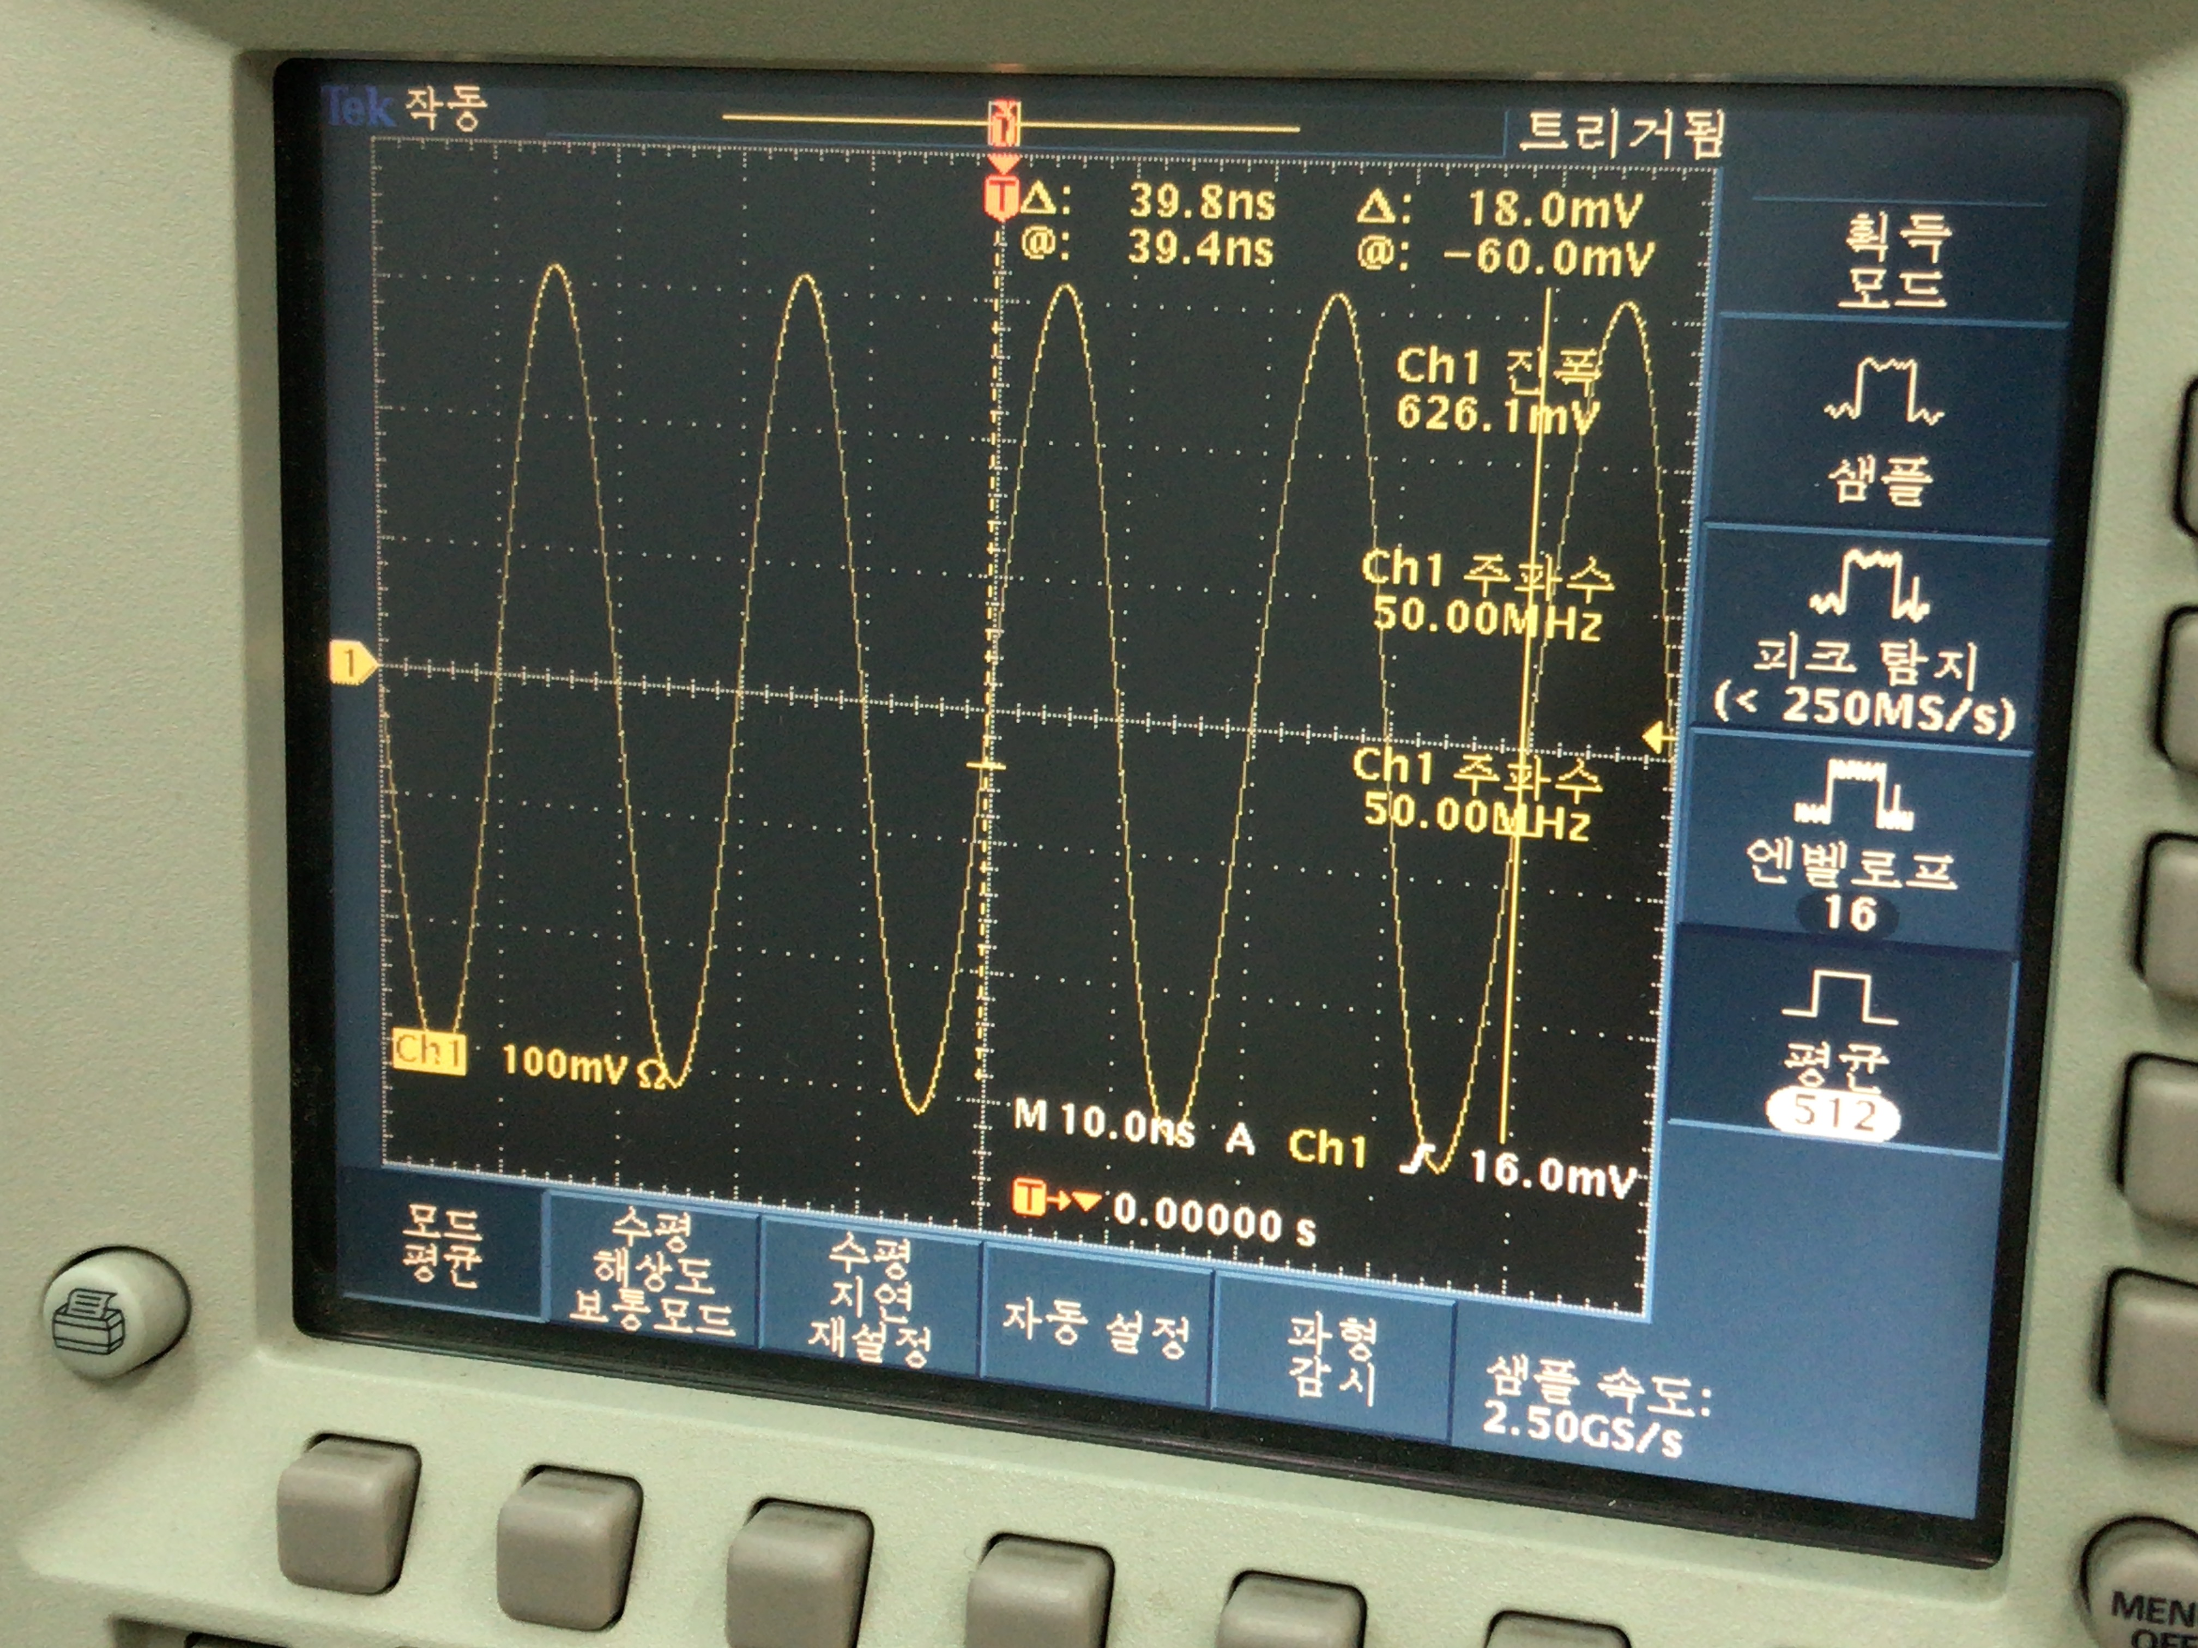
AD9910 evaluation board
Tested using modified AD9912 Verilog code
Python code for AD9910 is written

Slide 7
Modification of AD9912 code
DDS_clock
rsclk
rcsbar_1
changed to DDS IOUPDATE
rcsbar_2
ja_7
DDS1_powerdown
ja_6
rsdio_1
ck_io_6
ldac_bar
ja_5
ck_io_39
DAC_cs_bar[0]
[1:0] DAC_cs_bar
ja_4
DDS_reset
ck_io_38
DAC_sclk[0]
[1:0] DAC_sclk
ja_3
ck_io_37
DAC_sdi[0]
[1:0] DAC_sdi
ja_2
DDS2_powerdown
ck_io_36
DAC_cs_bar[1]
ja_1
rsdio_2
ck_io_35
DAC_sclk[1]
ja_0
ck_io_34
DAC_sdi[1]

Slide 8
while(1):
print('[1] set_frequency(self, freq, ch1, ch2, unit = \'MHz\')’)
…
order = input('select funct you want to implement')
if( order == '1' ):
freq_in_MHz = float(input('freq_in_MHz : '))
ch1 = int(input('ch1 : '))
ch2 = int(input('ch2 : '))
dds.set_frequency(freq_in_MHz, ch1, ch2)
…
elif( order == '4' ):
freq = float(input('freq : '))
phase = float(input('phase : '))
amplitude = float(input('amplitude : '))
ch1 = int(input('ch1 : '))
ch2 = int(input('ch2 : '))
profile = int(input('profile : '))
dds.set_profile(freq, phase, amplitude, ch1, ch2, profile
= 0, unit_freq = 'MHz', unit_phase = 'FRAC')
elif( order == '5'):
dds.io_update()
elif( order == '6'):
ch1 = int(input('ch1 : '))
ch2 = int(input('ch2 : '))
dds.set_CFR1(ch1, ch2)

Slide 9
New AD9910 Verilog code
Use Same main FSM
Read & Write is available
4 SPI mode, length of signal can be selected
auto mode available (using FIFO)
Error register added (busy, overrided, overflow, timestamp)
Parallel output available
SPI configuration
lsb_first
slave_en
end_spi
[4:0]dummy
[7:0]cs
[4:0]length
cspol
cpol
cpha
[7:0]clk_div
auto mode data
[127:112] dummy
[111:95] dest
[95:32] timestamp
[31:0] data
[15:12] dest
[11:0] dest
override data
functionality
module
[63:48] dummy
[47:95] dest
[31:0] data

Slide 10
[15:12] dest
[11:0] dest
IO update
gpo_core
rto_core
main FSM
destination check
Parallel
fifo
Profile
SPI module
gpi_core
rti_core
destination check
fifo

Slide 11
write process
config_int_list1 = self.set_config(cs = ((ch2 << 1) | (ch1 << 0)),
length = 8)
addr_int_list = self.make_write_list(register_addr << 24)
config_int_list2 = self.set_config( cs = ((ch2 << 1)|(ch1 << 0)), length = 32, end_spi = 1 )
data_int_list = self.make_write_list(register_data)
self.fpga.send_mod_BTF_int_list(config_int_list1)
self.fpga.send_command('WRITE DDS REG')
self.fpga.send_mod_BTF_int_list(addr_int_list)
self.fpga.send_command('WRITE DDS REG')
self.fpga.send_mod_BTF_int_list(config_int_list2)
self.fpga.send_command('WRITE DDS REG')
self.fpga.send_mod_BTF_int_list(data_int_list)
self.fpga.send_command('WRITE DDS REG')

Slide 12
jb_1
F[1]
jb_0
F[0]
IOBUF
ja_7
DDS1_ioupdate
jc_7
ja_6
io[0]
jc_6
ja_5
cs1
jc_5
ja_4
DDS1_TxEnable
jc_4
ja_3
sck
IOBUF
jc_3
ja_2
DDS2_ioupdate
jc_2
[17:0] parallel_out
ja_1
io[1]
jc_1
ja_0
cs2
jc_0
jb_7
[2:0]DDS1_profile
jd_7
jb_6
jd_6
jb_5
jd_5
jb_4
[2:0]DDS2_profile
jd_4
jb_3
jd_3
jb_2
jd_2
jd_1
jd_0

Slide 13
Example Code (auto mode)
def exp1():
dds = AD9910(ArtyS7('COM12'))
dds.reset_driver()
dds.auto_mode()
dds.set_profile_register(ch1 = 1, ch2 = 1, freq = 50 * MHz, phase = 0 * RAD,
amplitude = 1.0, profile = 0)
dds.delay_cycle(10000)
dds.set_profile_register(ch1 = 1, ch2 = 1, freq = 100 * MHz, phase = 0 * RAD,
amplitude = 1.0, profile = 1)
dds.delay_cycle(10000)
dds.set_profile_pin(profile1 = 1, profile2 = 0)
dds.auto_start()
UartRx
reset_driver
set_profile_register
set_profile_register
set_profile_pin
auto_start
counter
0
10000
20000
CSB
profile
0
1

Slide 14
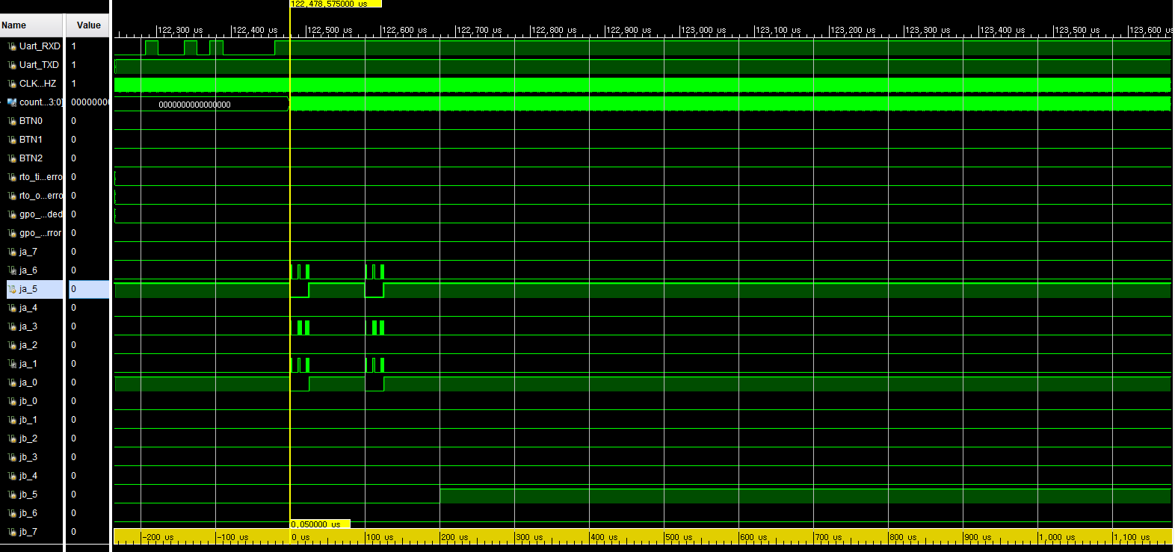
exp1 waveform

Slide 15
Example Code (auto mode)
def exp2():
dds = AD9910(ArtyS7('COM12'))
dds.reset_driver()
dds.auto_mode()
dds.delay_cycle(500)
dds.set_profile_register(ch1 = 1, ch2 = 1, freq = 50 * MHz, phase = 0 * RAD,
amplitude = 1.0, profile = 0)
dds.set_parallel_amplitude(amplitude = 1.0, parallel_en = 1)
dds.auto_start()
dds.read_exception_log()

Slide 16
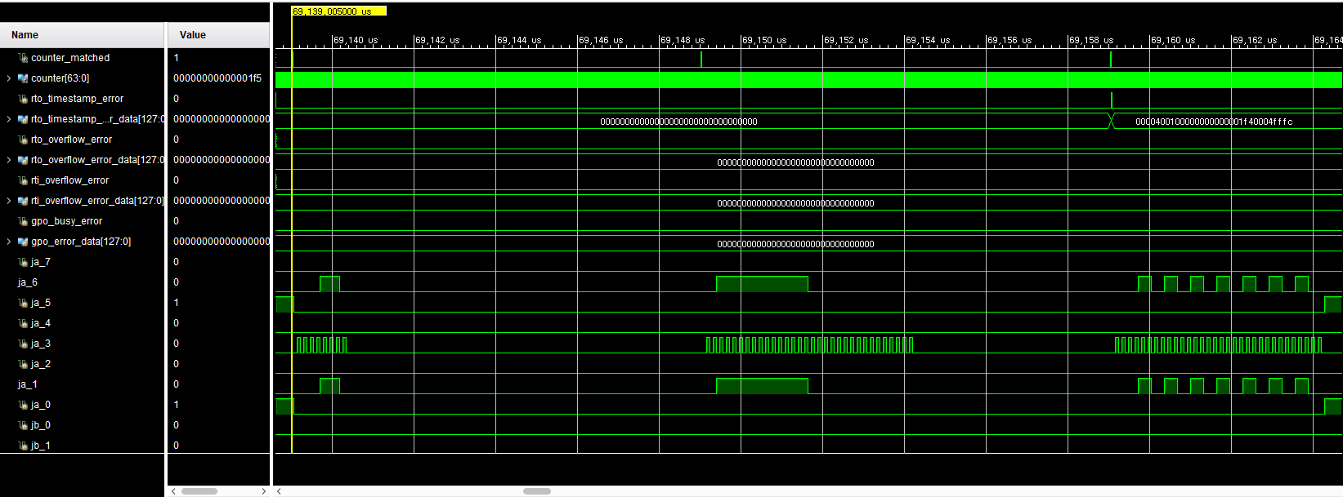
exp2 waveform

Slide 17
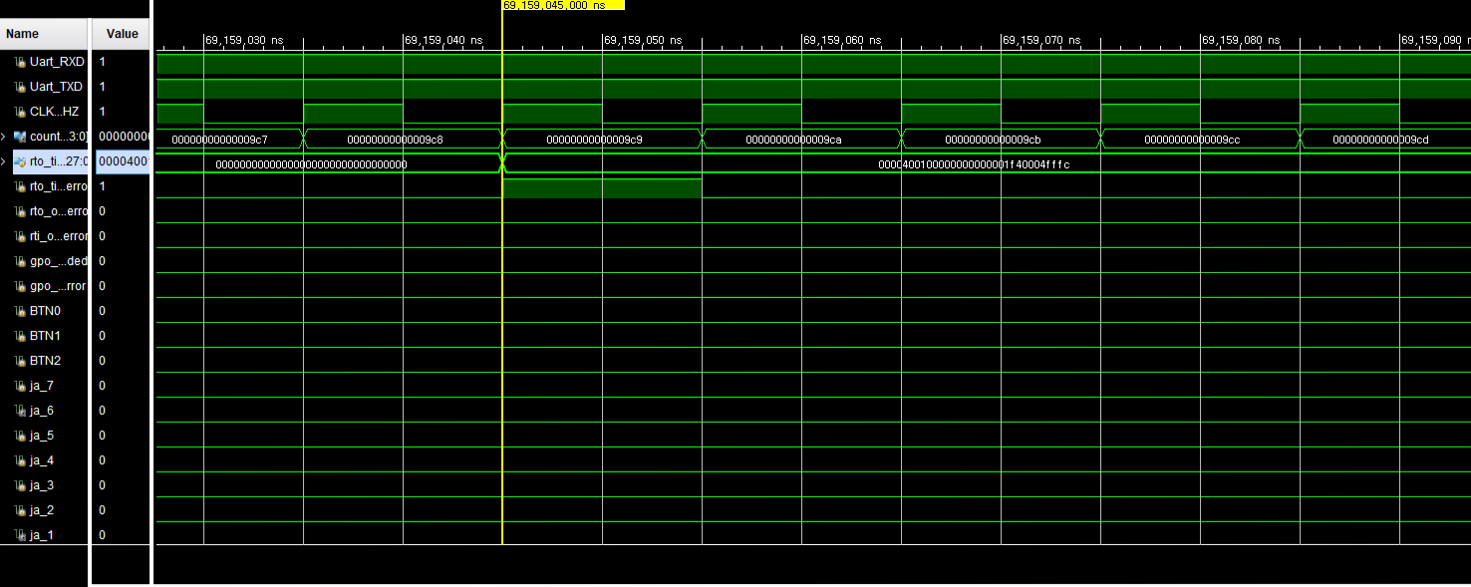
exp2 waveform

Slide 18
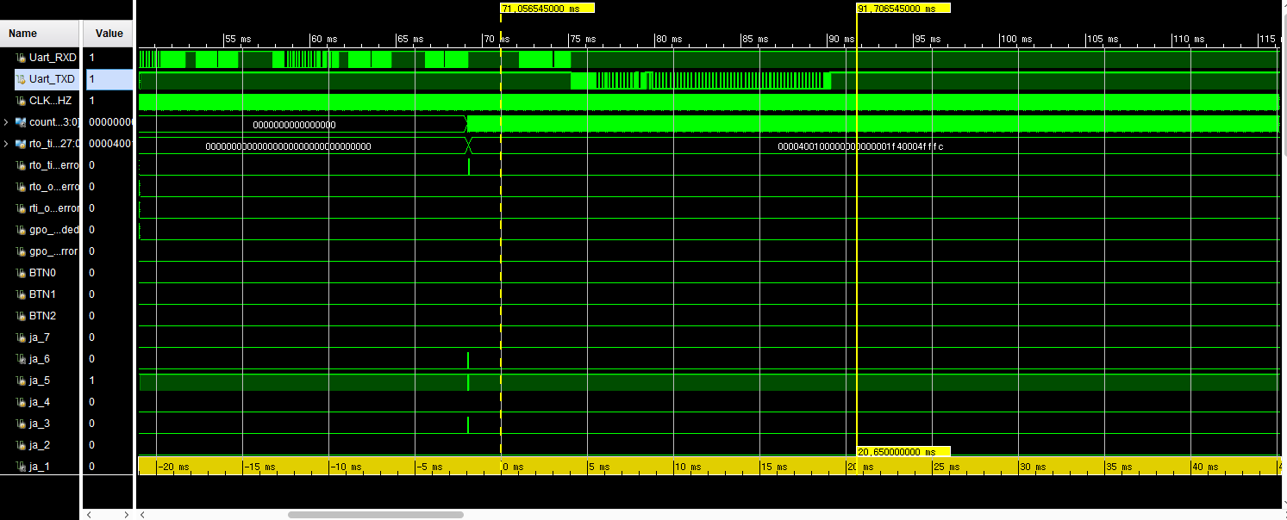
exp2 waveform

Slide 19
error data
#3 041
0b0010000
0x0000400100000000000001f40004fffc
000…000
\r \n
length
error
error data

Slide 20
Example Code (override)
def exp3():
dds = AD9910(ArtyS7('COM12'))
dds.reset_driver()
dds.override_enable()
dds.set_profile_register(ch1 = 1, ch2 = 1, freq = 50 * MHz, phase = 0 * RAD,
amplitude = 1.0, profile = 0)
dds.set_profile_register(ch1 = 1, ch2 = 1, freq = 100 * MHz, phase = 0 * RAD,
amplitude = 1.0, profile = 1)
dds.set_profile_pin(profile1 = 1, profile2 = 0)
dds.set_parallel_amplitude(amplitude = 1.0, parallel_en = 1)
dds.initialize(1,1)
dds.read32(1,0,0x00)
dds.read32(0,1,0x01)
dds.read32(1,0,0x02)
dds.read_rti_fifo()
dds.read_rti_fifo()
dds.read_rti_fifo()
dds.read_rti_fifo()
dds.read_rti_fifo()

Slide 21
spi_core(AD9910_1)
rto_core(rto_core)
gpo_core(spi_config)
[63:0]gpo_out
[127:0]error_data
busy
single_spi_output
SPI_FSM
overrided
counter_matched
timestamp_error
sck
sdi
selected
overflow_error
busy_error
[127:0]rto_out
mosi
sdo
counter_matched
[31:0]rd_data
miso
slave_en
[127:0]gpo_in
full
cs
cspol
[63:0]override_value_input
empty
cpol
override_en_input
auto_start
cpha
selected_input
[31:0]wr_data
spi_off
reset
new_in
write
cs_next
counter
sck_next
[63:0]counter
cs
gpi_core
read
[31:0]din
[4:0]addr
[63:0]counter
data_ready
clk
write
[127:0]gpi_out
[15:0]dest
[4:0]addr
[127:0]timestamp_error_data
simple_output(io_update)
read
[127:0]overflow_error_data
[31:0]rd_data
rti_core()
simple_output(profile)
cs
[127:0]rti_in
[127:0]timestamp_error_data
write
read
simple_output(parallel)
[4:0]addr
[31:0]rd_data
[63:0]counter

Slide 22
mini_gpo_core(AD9910 control)
channel check
FSM
destination check
rto_core
fifo
spi_core(AD9910_1)
destination check
rto_core
fifo
mini_gpo_core(Others1)
channel check
destination check
rto_core
mini_gpo_core(Others2)
fifo
destination check
1. wasting resource which is not used many time
and parallel output is not always required
2. need to update fifo in real time
rti_core
fifo

Slide 23
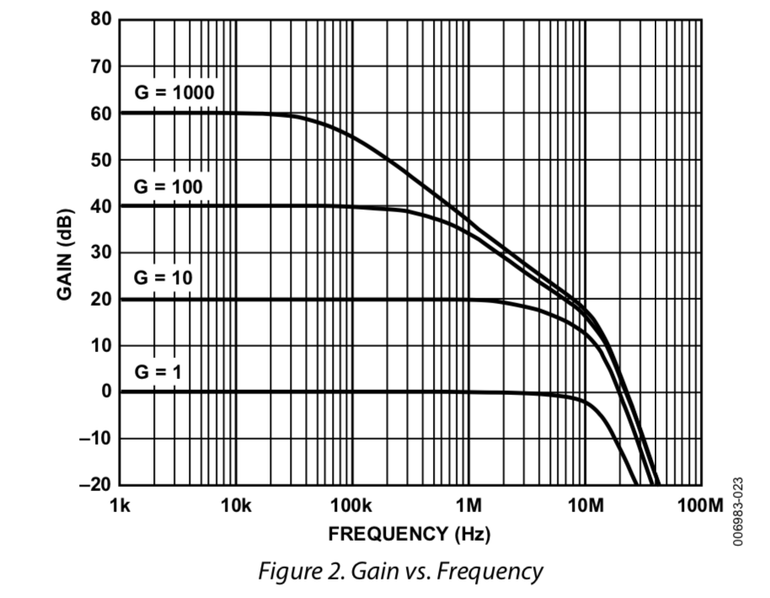
ADC Sampler
Sampler Spec
- 8-channel
- 16-bit 1.5MSPS ADC LTC2320-16 ( $48.66 )
- 8 PGIA AD8253 ( $11.36 )
G = 1, 10, 100, 1000
- Basic mode : Sequential input, 700kHz
use single EEM
- Fast mode : Simultaneous input, 1MHz
use dual EEM
- Sample – Urukul Servo mode possible
- USD $1,600
2 x EEM port
ADC chip
8 x PGIA chip
IDC
8 x BNC

Slide 24
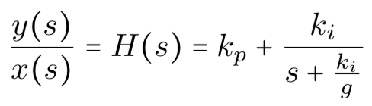
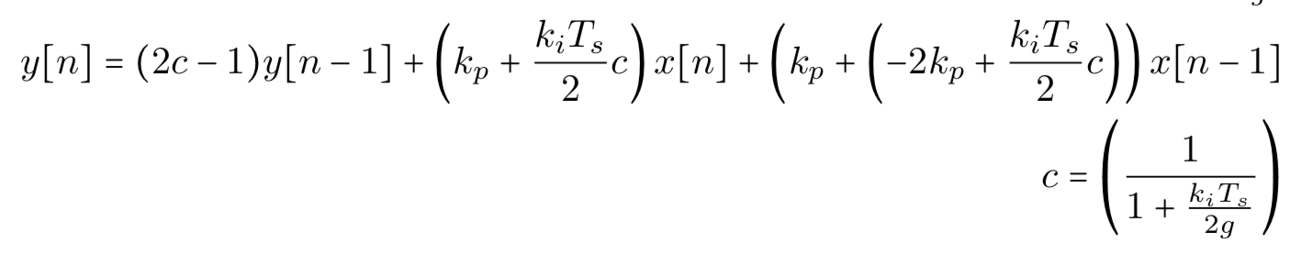
Sampler – Urukul Servo mode (SUSERVO)
- Use IIR Filter
- DSP is implemented on main processor
- 2 Urukul board per 1 Sampler board

